Slide 1
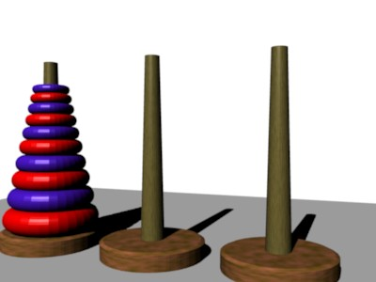
TOWER OF HANOI (using 4 towers and N discs)
By,
BHAGYASHREE.V
LIKITHA.S
SHALINI.K.P
BHAGYASHREE.V | 1KS18CS128
LIKITHA.S | 1KS18CS130
SHALINI.K.P | 1KS18CS131

Slide 2
HISTORY OF TOWER OF HANOI:
History of Towers of Hanoi. Édouard Lucas, the popular French mathematician invented this game in the year 1883. There is an interesting story attached to this game. It is believed that a team of eastern monks are guarding the three towers situated in a Vietnamese temple. These towers are surrounded by 64 golden rings.

Slide 3
OBJECTIVE:
Move discs from tower 1 (source tower)to tower 2(destination tower) by using tower 3 and tower 4 as (temporary towers).
Tower 1=source Tower.
Tower 2=destination Tower.
Tower 3 and Tower 4 = Temporary Towers.
→By using 4 towers/pegs/rods decreases in time complexity.

Slide 4
RULES FOR TOWER OF HANOI:
RULE 1:
Only one disc can be moved at a time.
RULE 2:
No disc can be placed on top of the smaller disc.

Slide 5
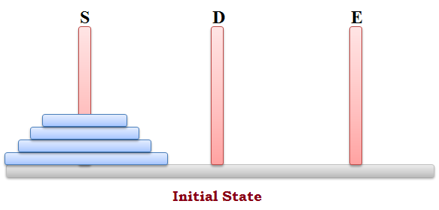
EXAMPLE:
Let us consider N as 4.N = 4 discs .
4 towers = ‘A’,’B’,’C’,’D’.
Initial condition .all 4 discs should be in tower A.
A B C D

Slide 6
2
3
3
4
1
4
1
2
STEP 1
STEP 2
3
1
1
4
2
4
2
3
STEP 3
STEP 4
3
1
1
4
2
4
2
3
STEP 5
STEP 6

Slide 7
2
3
3
4
1
4
1
2
STEP 7
STEP 8
1
2
3
4
STEP 9

Slide 8
OUTPUT:
STEP 1:Move disc 1 from rod A to rod B.
STEP 2:Move disc 2 from rod A to rod C.
STEP 3:Move disc 1 from rod B to rod C.
STEP 4:Move disc 3 from rod A to rod D.
STEP 5:Move disc 4 from rod A to rod B.
STEP 6:Move disc 3 from rod D to rod B.
STEP 7:Move disc 1 from rod C to rod D.
STEP 8:Move disc 2 from rod C to rod B.
STEP 9:Move disc 1 from rod D to rod B.

Slide 9
Final state : after moving discs from tower A to TOWER B.
A B C D
1
2
3
4

Slide 10


